Slide 1
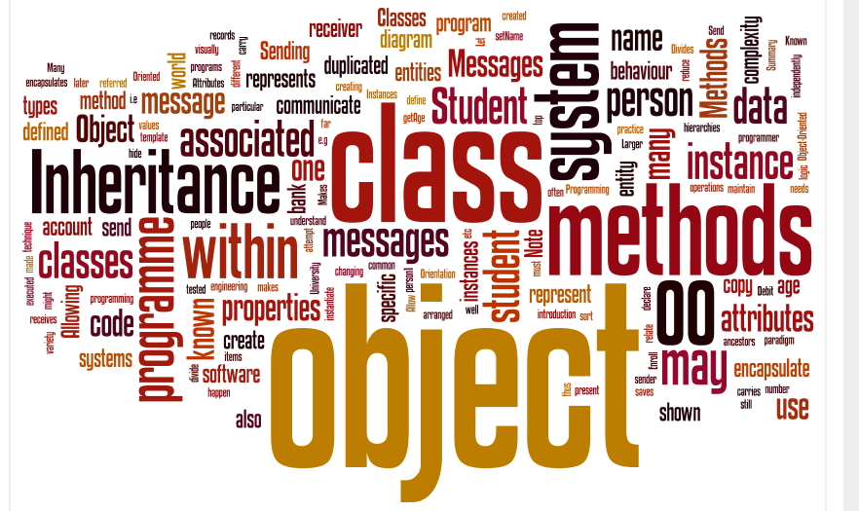
An intro to C#
Neil Urquhart

Slide 2
Multi-Layered Framework
This week will concentrate on creating a GUI project
Such a project can be used to form the Presentation Layer in a multi-layer system
Notes:
123-124

Slide 3
Creating a new WPF project 1
We are going to create a new project within Visual Studio
We will use the Windows Presentation Framework (WPF) to construct a GUI
Notes:
123-124

Slide 4
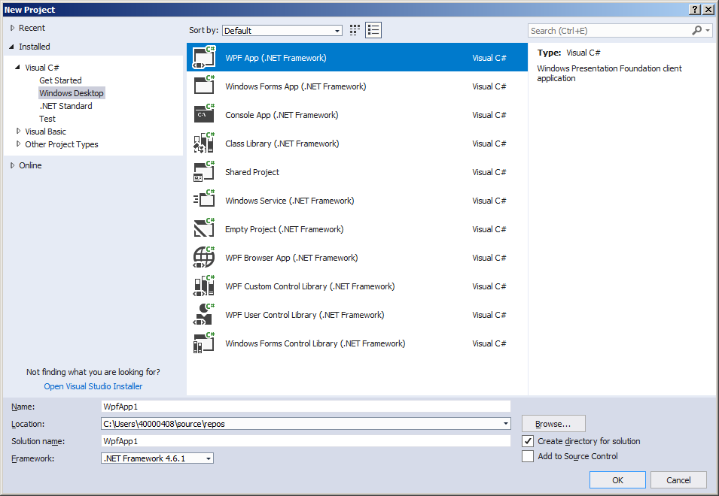
Creating a new WPF project 3
Close the “Start Page”
Select File-> New Project…
Notes:
123-124

Slide 5
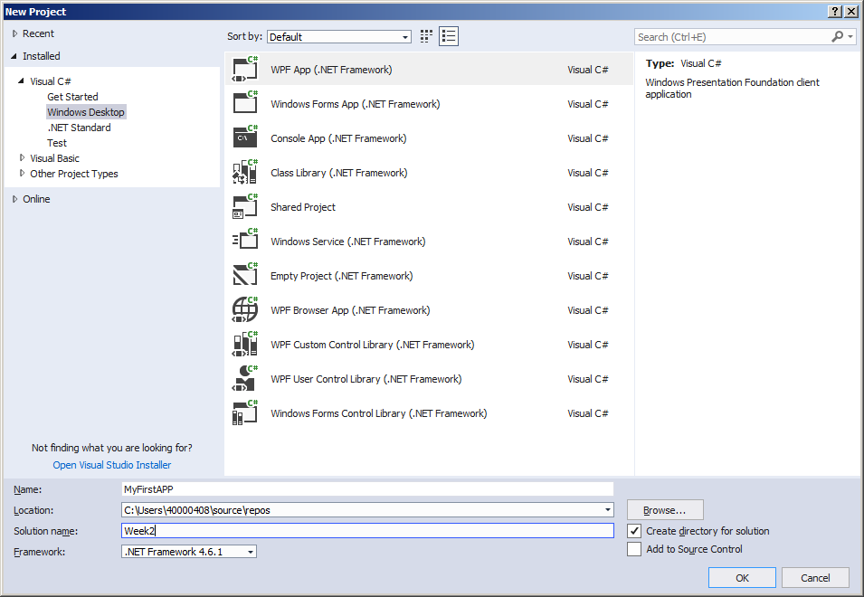
Creating a new WPF project 4
Select WPF application
Give your project a name
Give your solution a name
Leave the location alone
Click OK….
Notes:
123-124

Slide 6
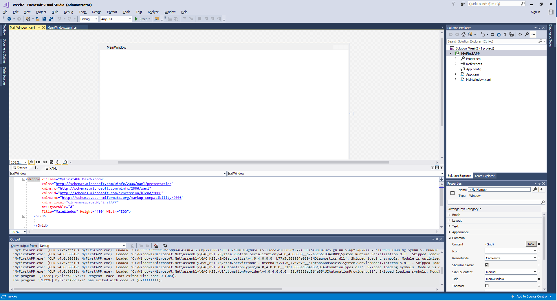
Creating a new WPF project 5
Your application has been created, so far it comprises a blank window, with no controls ….
Click on the start button on the tool bar to run your application
Notes:
123-124

Slide 7
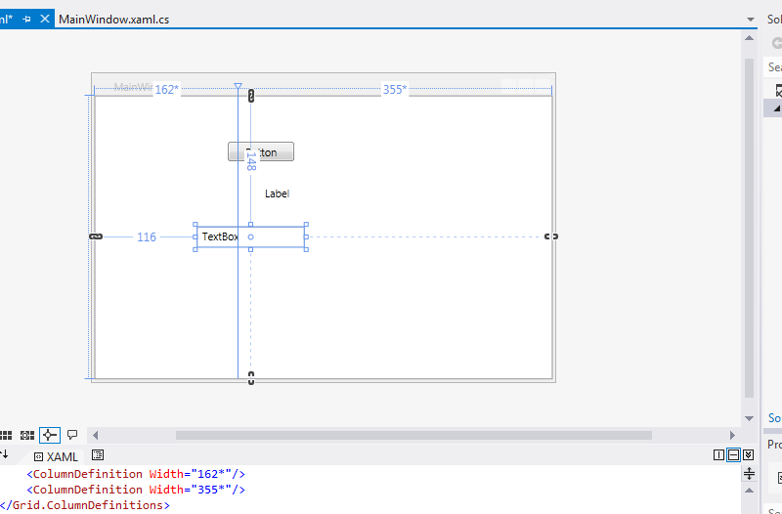
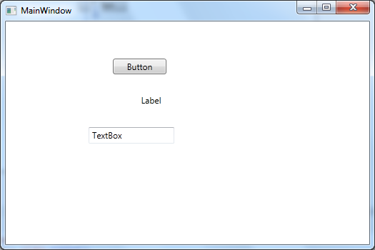
Adding Controls
Our application looks somewhat basic at present
In order to build a useful GUI we can use control components
Most of the controls supplied within WPF will be familiar to windows users
Examples include Buttons, Labels, Text boxes etc
3 Controls dropped onto the form at design time (left) and the resulting runtime form (right)
Notes:
123-124

Slide 8
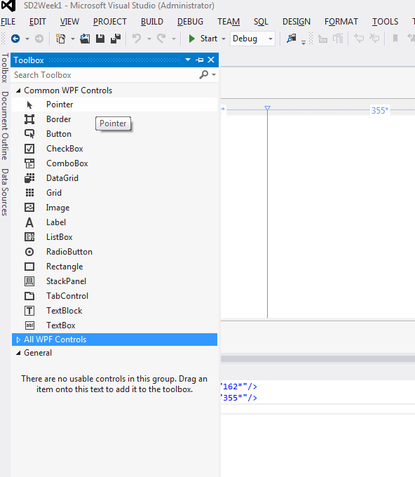
Adding Controls
Controls may be found in the ToolBox
Either click on the sidebar option “Tool Box” or View->Toolbox
Notes:
123-124

Slide 9
Adding Controls
Controls may be dragged from the toolbox and positioned on the form at design time
Control name | Description
System.Windows.Controls.Border | Displays a border around content.
System.Windows.Controls.Button | Enables a user to perform an action by clicking a button. The Buttonbase.Click event occurs when a Button is clicked.
System.Windows.Controls.CheckBox | Enables a user to select and clear a check box to indicate a Yes/No or True/False value.
System.Windows.Controls.ComboBox | Enables a user to select an item from a drop-down list. The list is displayed when the user clicks a drop-down arrow.
System.Windows.Controls.Grid | Defines a flexible grid area that consists of columns and rows.
System.Windows.Controls.Image | Displays an image.
System.Windows.Controls.Label | Displays text on a form. Provides support for access keys.
System.Windows.Controls.ListBox | Enables a user to select an item from a list.
System.Windows.Controls.RadioButton | Enables a user to choose from among mutually exclusive items. The selection of one radio button is mutually exclusive to any other radio button in the same container.
System.Windows.Controls.StackPanel | Enables you to stack child controls vertically or horizontally.
System.Windows.Control.TabControl | Enables visual content to be arranged in a tabular form.
System.Windows.Controls.TextBox | Displays unformatted text and enables users to enter text.
Notes:
123-124

Slide 10
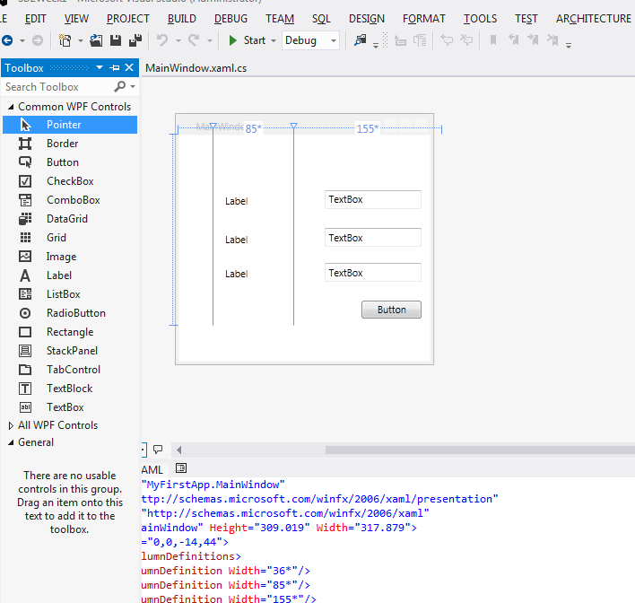
Control Properties
With practice you can soon position controls to create useful user-interfaces
The appearance of the controls still needs to be further customised
Notes:
123-124

Slide 11
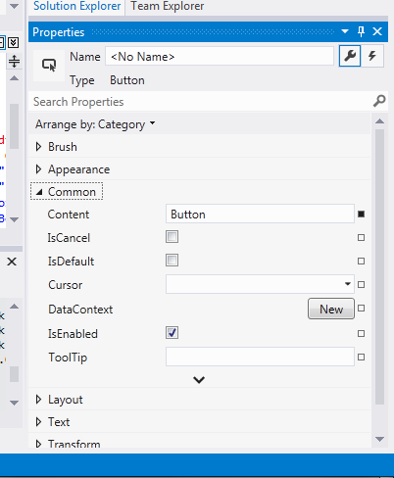
Control Properties
The properties of a control define it’s appearance and aspects of its behaviour.
Typical properties of a control might include
Position
Size
Visibility
Content (for controls such as text boxes)
Properties may be updated at design time through the properties window
Highlight the control and click alt-enter
(if not already visible)
Notes:
123-124

Slide 12
Control Names
Controls need to have a name
You use the name should you need to refer to the control from within your code
Add a suitable name as soon as you have added the control
One convention suggests that the first
three letters of the name should identify the
type
btn- button
lbl - label
Frm - form (window)
etc
Notes:
123-124

Slide 13
Control properties
We can alter the properties of a control at run time through code
Suppose we wish to make some hidden controls visible
private void btnAdvanced_Click(object sender, RoutedEventArgs e)
{
lblCourse.Visibility = Visibility.Visible;
cboCourse.Visibility = Visibility.Visible;
}
See example 1… “MyFirstApp
Notes:
123-124

Slide 14
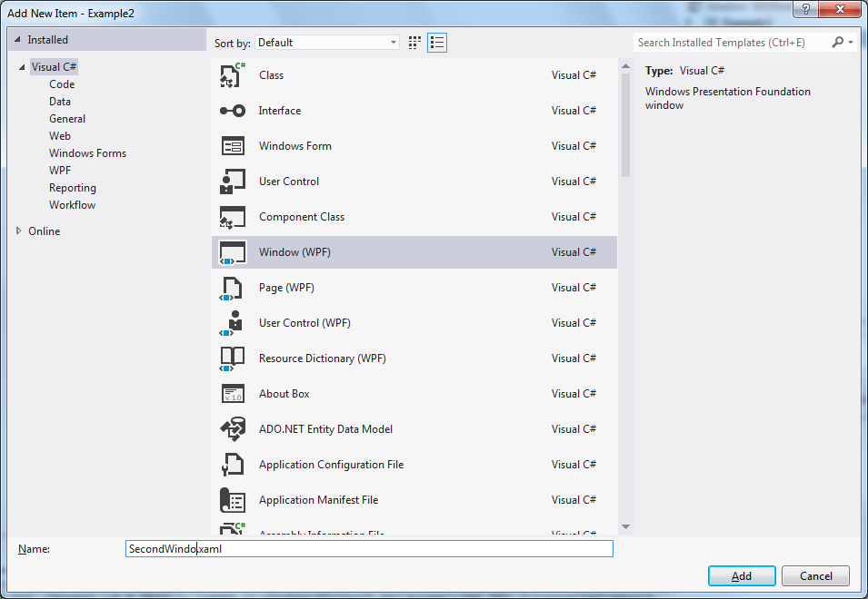
Managing Multiple Forms
Many of our applications will contain more than 1 form
Create a new project
First window created by default
To create an additional window
Right click on the project in Solution Explorer
Select Add -> Window
Select Window(WPF) and give it a name
Notes:
123-124

Slide 15
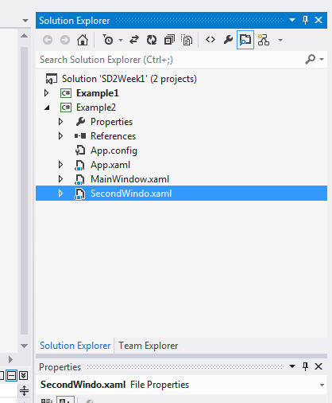
Managing Multiple Forms
Solution explorer will now show 2 windows
You can double click the second one and add controls as you required
Notes:
123-124

Slide 16
Managing Multiple Forms
To show the second form use the following code in the event handler of the button on the first form
private void btnOpenForm_Click(object sender, RoutedEventArgs e)
{
SecondWindow newWin = new SecondWindow();
newWin.Show();
}
This assumes our new window was called SecondWindow.
This code is creating a new object called newWin based on the class SecondWindow
Show() is a method within the SecondWindow class that draws the window on the screen
Don’t worry about this – this will become clear over the next few weeks!
Notes:
123-124

Slide 17
Managing Multiple Forms
To close the new Window….
Add a button to SecondWindow called btnClose
Add the following event handler
private void btnClose_Click(object sender, RoutedEventArgs e)
{
this.Close();
}
Again, there’s some OO here which will become clear over the next few weeks
This refers to the current object
Close() is a method within Window (supplied as part of .NET) that closes the window
See example2 in Visual Studio
Notes:
123-124

Slide 18
Events
We can now create forms with controls on them
We can modify the appearance of these controls by altering their properties
But our interface does not react to any input from the user
E.g. clicking on a button
When the user interacts with a control and the software needs to respond an event is raised
For instance clicking on a button raises a click event associated with that button
Notes:
123-124

Slide 19
Events
Events are continuously being handled by the Windows OS
Keystrokes
Mouse movement
Mouse click
Network packets received
Events which affect our application are passed to the application
.NET deals with events, and by default ignores them
But for certain events we wish to specify a behaviour
We do this by creating an event handler
Notes:
123-124

Slide 20
Event Handlers
The event handler is a C# method that is called in response to an event
We only have to write the method the link between the OS and the handler is managed by .NET
Controls can have range of event handlers to cover different user actions
Let’s take a look at how to create an event handler for a button
We’ll handle the most common event a click
Notes:
123-124

Slide 21
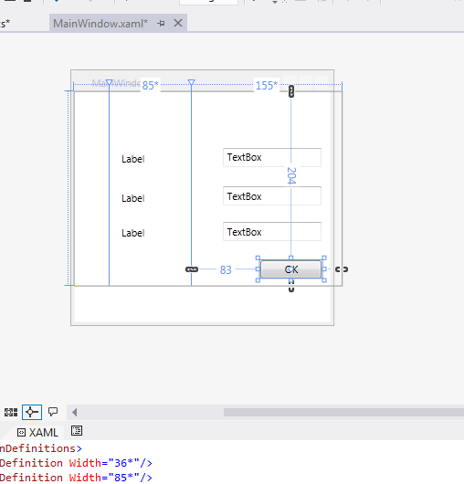
Handling an event
Assume that we have a button on our form
Before creating an event handler make sure the button has a sensible name!
Notes:
123-124

Slide 22
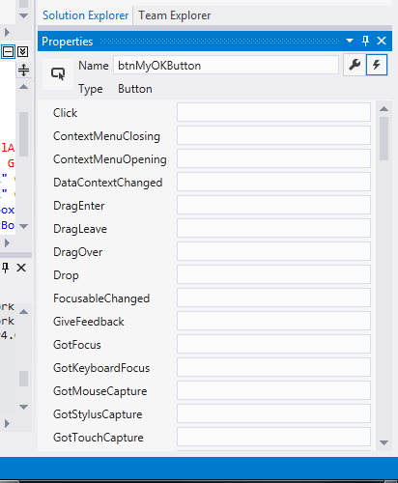
Handling an event
Highlight the button
Bring up the properties window
Select the event tab
The “lightening flash” in the top right of properties
This gives us a list of all the possible events for the selected control
In this example the event handlers are blank as none have been created
To create the event handler method and associate it, dbl click the Click field
Notes:
123-124

Slide 23
Our first event handler
The default event handler as created should look like this:
private void btnMyOKButton_Click(object sender, RoutedEventArgs e)
{
}
This is a C# method (with no content!)
Don’t worry about the parameters
For advanced use they contain details about the event
Note the name is the control name and the event type
Notes:
123-124

Slide 24
Making our handler do something
Add the following code to your handler
MessageBox.Show("You have clicked on the button");
Run the app
Click the button
The handler will be called and the dialogue displayed
Notes:
123-124

Slide 25
Event Handlers
private void nextButton_Click(object sender,RoutedEventArgs e)
{
//Some code
}
A simple event handler (i.e. the one above) may be generated by double clicking a control

Slide 26
Event Handlers
private void nextButton_Click(object sender,RoutedEventArgs e)
{
//Some code
}
Convention uses the form <controlname>_<event> when naming an event handler method
You can call them anything that you wish!

Slide 27
Event Handlers
private void nextButton_Click(object sender,RoutedEventArgs e)
{
//Some code
}
Parameters
Sender
An object representing the control that generated the event
In the above example sends would be the nextButton object
RoutedEventArgs
An object containing more information regarding the event
This second parameter type will change depending on the event type
E.g. KeyEventArgs for events relating to keystrokes

Slide 28
Example
private void btnPrev(object sender, RoutedEventArgs e)
{
if (sender.GetType() == typeof(Button))
{
Button senderBtn = (Button)sender;
MessageBox.Show("Sender = " + senderBtn.Name);
}
}
Because sender is an object it could be C# type
GetType() and typeof() are used to check that Sender is a Button object
Sender is then cast to type button

Slide 29
Advanced: Associating Handlers with an event
The handler name is stored within the xaml that defines the form
<Button x:Name="btnNext" Content="Next" HorizontalAlignment="Left“ Margin="130,200,0,0" VerticalAlignment="Top" Width="75“ Click="btnPrevious_btnNext_Click" />
If the method is deleted from the .cs file, you may have to remove it from the xaml
Be careful when editing the xaml manualy!

Slide 30
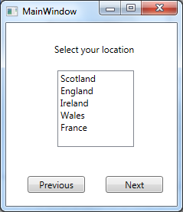
Multiple events to one handler
The previous and next buttons have very similar functions
We could use one event handler

Slide 31
Multiple events to one handler
private void btnPrevious_btnNext_Click(object sender, RoutedEventArgs e)
{
if (sender == btnPrevious)
{
MessageBox.Show("Previous clicked");
}
if (sender == btnNext)
{
MessageBox.Show("Next clicked");
}
}
Each control on our form is an object
Created when the form is created
We can test to see if Sender is a specific control object

Slide 32
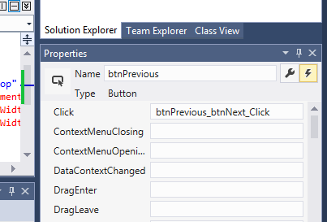
Multiple events to one handler
Properties explorer | events (flash icon)
Add in our new event handler name to both buttons

Slide 33
Changing event handlers at run time
Assigning events
txtMyText.MouseEnter += TextBox_MouseEnter;
txtMyText.MouseLeave += txtMyText_MouseLeave;
Removing events
txtMyText.MouseEnter -= TextBox_MouseEnter;
txtMyText.MouseLeave -= txtMyText_MouseLeave;
(Demo: event handlers)

Slide 34
Validation
Validation of input data should be carried out within a GUI
Check types
Is it numeric?
Check ranges
Check not blank

Slide 35
Validation: examples
try
{
age = Convert.ToInt32(txtAge.Text);
}catch
{
MessageBox.Show("Age must be a number");
age = 0;
}

Slide 36
Validation: examples
try
{
if (txtName.Text == "")
{
throw new System.ArgumentException("Field cannot be blank", "Name");
}
if ((age <18) || (age > 65))
{
throw new System.ArgumentException("Age must be in the range 18 to 65", "Age");
}
MessageBox.Show("Validated succesfully");
}
catch (ArgumentException ex)
{
MessageBox.Show(ex.Message);
}

Slide 37
Summary
We’ve introduced
.NET
Visual Studio
C#
wpf
We’ve worked with
Windows
Adding controls
Controls
Properties
Events
Events & Event Handlers
Modifying control properties
Making windows visible
Hiding Windows
Notes:
123-124

Slide 38
Summary
We understand the basic principles of building a GUI using WPF and C#
Many developers commence an implementation by building the GUI
This is a big part of Agile development
Allows users to see what the finished product will look like
Sometimes called Rapid Prototyping
Notes:
123-124

